Slide 1


Slide 2
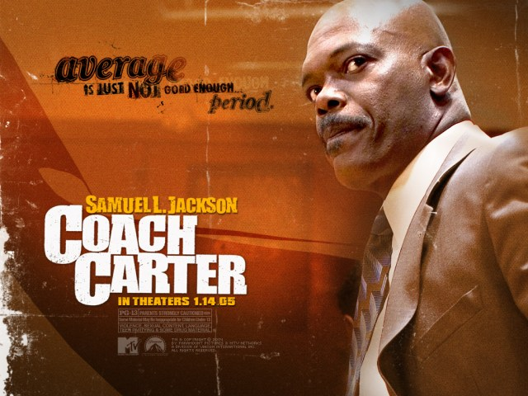
A sports goods store owner accepts the job of a basketball coach for his old high school, where he was a champion athlete. Dismayed by the attitudes of his players, he sets out to change things.

Slide 3
'And Jesus came and said to them, “All authority in heaven and on earth has been given to me.
Go therefore and make disciples of all nations, baptizing them in the name of the Father and of the Son and of the Holy Spirit, teaching them to observe all that I have commanded you.
And behold, I am with you always, to the end of the age.”'
Matthew 28:18-20

Slide 4
… And Jesus said to Simon, “Do not be afraid; from now on you will be catching men.” '
Luke 5:10

Slide 5
A Workable Process
Identify – Look for them
Look for those with F.A.I.T.H.
F – Faithful
A – Available
I – Involved
T – Teachable
H - Hungry

Slide 6
A Workable Process
Identify – Look for them
Instruct – Teach them the way
Ex. Servant Leadership and Being Missional

Slide 7
A Workable Process
Identify – Look for them
Instruct – Teach them the way
Impart – Impart the what can not be taught
Some things can only be caught through impartation

Slide 8
A Workable Process
Identify – Look for them
Instruct – Teach them the way
Impart – Impart the what can not be taught
Intern – Lead with me
Watch me lead, learn lead with me, LEAD with me

Slide 9
'Let no one despise you for your youth, but set the believers an example in speech, in conduct, in love, in faith, in purity. '
1 Timothy 4:12

Slide 10
Big Idea:
God grows leaders by spotting potential, building character, and giving opportunity.

Slide 11
Spot the Potential
Look for teachability, not perfection.
Jesus chose fishermen, not professionals.
Hunger > hype.
Look for humility, consistency, and heart.

Slide 12
Train the person
Character before capability.
Gifts open doors, character keeps them open.
Model before you manage.
Mentorship happens through relationship.

Slide 13
Launch and let Grow
Give responsibility and trust God with the results.
Don’t wait for ‘ready’ — train as they go.
Empowerment > control.
Growth comes from doing.

Slide 14
God doesn’t build monuments — He builds movements.
Let’s raise runners who keep the faith moving forward.

